Slide 1
Chapter 1: Module 2: Switching Concepts
Switching, Routing, and Wireless Essentials v7.0 (SRWE)
Notes:
Cisco Networking Academy Program
Switching, Routing and Wireless Essentials v7.0 (SRWE)
Module 2: Switching Concepts

Slide 2
Module Objectives
Module Title: Switching Concepts
Module Objective: Explain how Layer 2 switches forward data.
Topic Title | Topic Objective
Frame Forwarding | Explain how frames are forwarded in a switched network.
Switching Domains | Compare a collision domain to a broadcast domain.
Notes:
2
2 – Switching Concepts
2.0 – Introduction
2.0.2 – What will I learn to do in this module?

Slide 3
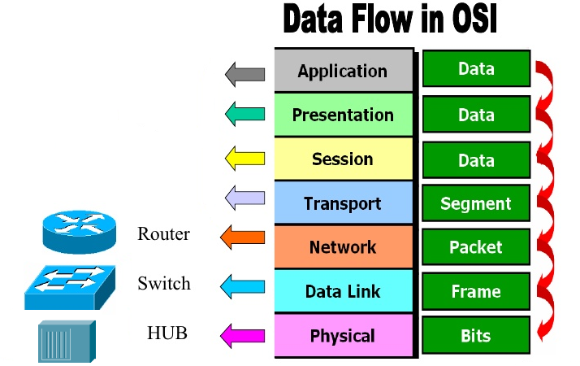

Slide 4
2.1 Frame Forwarding
Notes:
2 – Switching Concepts
2.1 – Frame Forwarding

Slide 5
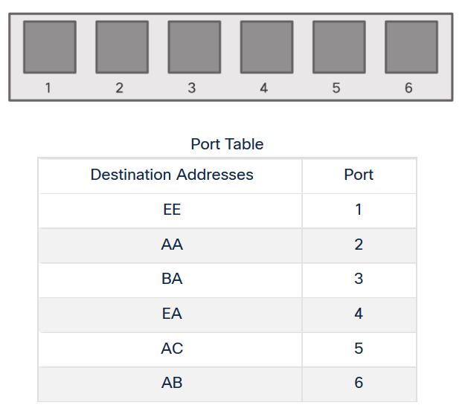
Frame Forwarding Switching in Networking
Two terms are associated with frames entering or leaving an interface:
Ingress – entering the interface
Egress – exiting the interface
A switch forwards based on the ingress interface and the destination MAC address.
A switch uses its MAC address table to make forwarding decisions.
Note: A switch will never allow traffic to be forwarded out the interface it received the traffic.
Notes:
2 – Switching Concepts
2.1 – Frame Forwarding
2.1.1 – Switching in Networking

Slide 6
Frame Forwarding The Switch MAC Address Table
A switch will use the destination MAC address to determine the egress interface.
Before a switch can make this decision it must learn what interface the destination is located.
A switch builds a MAC address table, also known as a Content Addressable Memory (CAM) table, by recording the source MAC address into the table along with the port it was received.
Notes:
2 – Switching Concepts
2.1 – Frame Forwarding
2.1.2 – The Switch MAC Address Table

Slide 7
Frame Forwarding The Switch Learn and Forward Method
The switch uses a two step process:
Step 1. Learn – Examines Source Address
Adds the source MAC if not in table AAAA
Resets the time out setting back to 5 minutes if source is in the table
Step 2. Forward – Examines Destination Address
If the destination MAC is in the MAC address table it is forwarded out the specified port.
If a destination MAC is not in the table, it is flooded out all interfaces except the one it was received.
Notes:
2 – Switching Concepts
2.1 – Frame Forwarding
2.1.3 – The Switch Learn and Forward Method

Slide 8
Frame Forwarding Video – MAC Address Tables on Connected Switches
This video will cover the following:
How switches build MAC address tables
How switches forward frames based on the content of their MAC address tables
Notes:
2 – Switching Concepts
2.1 – Frame Forwarding
2.1.4 – Video – MAC Address Tables on Connected Switches

Slide 9
Frame Forwarding Switch Forwarding Methods
Switches use software on application-specific-integrated circuits (ASICs) to make very quick decisions.
A switch will use one of two methods to make forwarding decisions after it receives a frame:
Store-and-forward switching - Receives the entire frame and ensures the frame is valid. Store-and-forward switching is Cisco’s preferred switching method.
Cut-through switching – Forwards the frame immediately after determining the destination MAC address of an incoming frame and the egress port. Cut-through switching mode is enabled by default.
Notes:
2 – Switching Concepts
2.1 – Frame Forwarding
2.1.5 – Switch Forwarding Methods

Slide 10
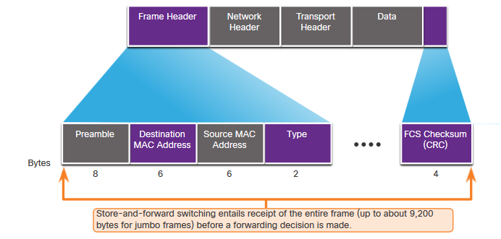
Frame Forwarding Store-and-Forward Switching
Store-and-forward has two primary characteristics:
Error Checking – The switch will check the Frame Check Sequence (FCS) for CRC errors. Bad frames will be discarded.
Buffering – The ingress interface will buffer the frame while it checks the FCS. This also allows the switch to adjust to a potential difference in speeds between the ingress and egress ports.
switch(config) # switching-mode store-forward
Notes:
2 – Switching Concepts
2.1 – Frame Forwarding
2.1.6 – Store-and-Forward Switching

Slide 11
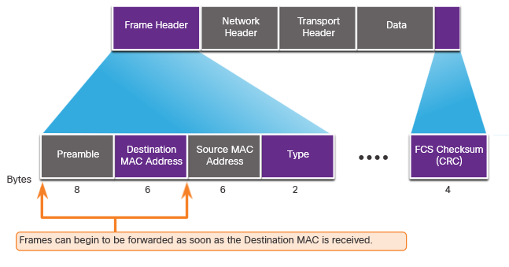
Frame Forwarding Cut-Through Switching
Cut-through forwards the frame immediately after determining the destination MAC.
Fragment (Frag) Free method will check the destination and ensure that the frame is at least 64 Bytes. This will eliminate runts.
Concepts of Cut-Through switching:
Is appropriate for switches needing latency to be under 10 microseconds
Does not check the FCS, so it can propagate errors
May lead to bandwidth issues if the switch propagates too many errors
Cannot support ports with differing speeds going from ingress to egress
Notes:
2 – Switching Concepts
2.1 – Frame Forwarding
2.1.7 – Cut-Through Switching
2.1.8 – Activity – Switch It!

Slide 12
2.2 Switching Domains
Notes:
2 – Switching Concepts
2.2 – Switching Domains

Slide 13
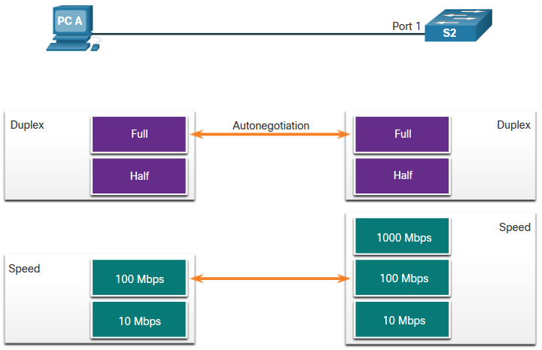
Switching Domains Collision Domains
Switches eliminate collision domains and reduce congestion.
When there is full duplex on the link the collision domains are eliminated.
When there is one or more devices in half-duplex there will now be a collision domain.
There will now be contention for the bandwidth.
Collisions are now possible.
Most devices, including Cisco and Microsoft use auto-negotiation as the default setting for duplex and speed.
Notes:
2 – Switching Concepts
2.2 – Switching Domains
2.2.1 – Collision Domains

Slide 14
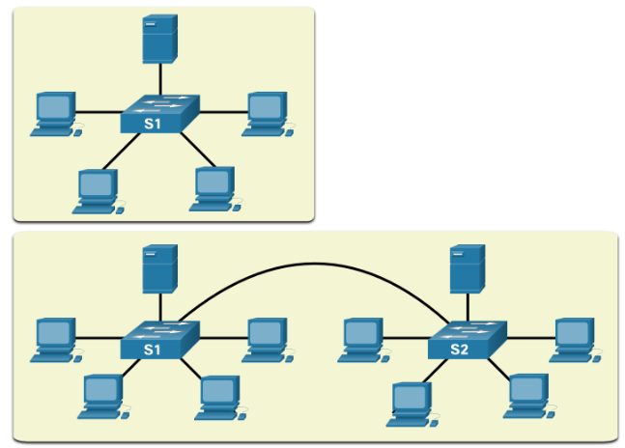
Switching Domains Broadcast Domains
A broadcast domain extends across all Layer 1 or Layer 2 devices on a LAN.
Only a layer 3 device (router) will break the broadcast domain, also called a MAC broadcast domain.
The broadcast domain consists of all devices on the LAN that receive the broadcast traffic.
When the layer 2 switch receives the broadcast it will flood it out all interfaces except for the ingress interface.
Too many broadcasts may cause congestion and poor network performance.
Increasing devices at Layer 1 or layer 2 will cause the broadcast domain to expand.
Notes:
2 – Switching Concepts
2.2 – Switching Domains
2.2.2 – Broadcast Domains

Slide 15
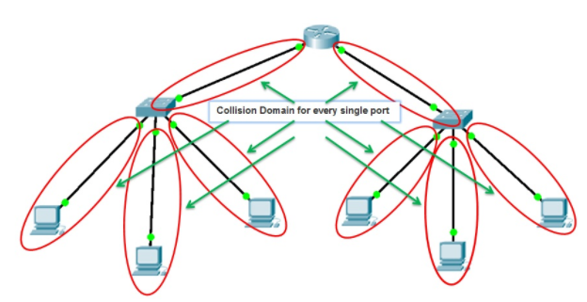
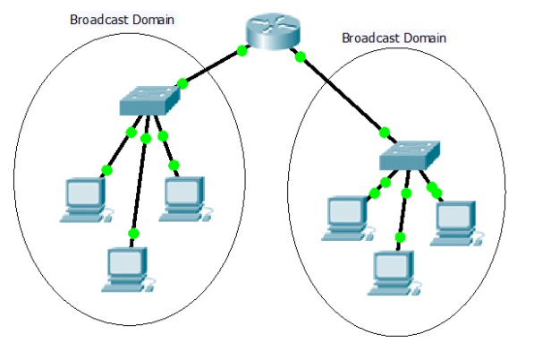
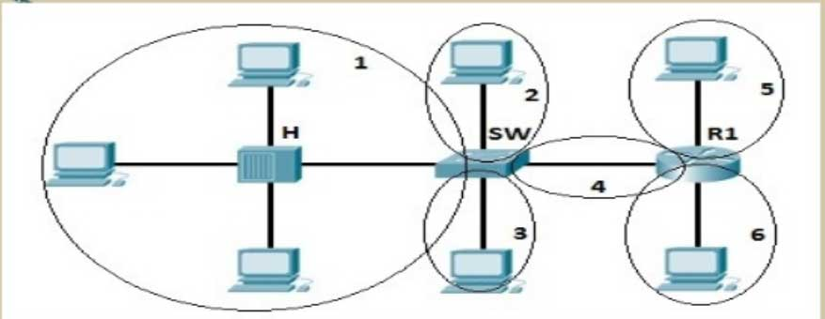
Collision Domain.

Slide 16
Switching Domains Alleviated Network Congestion
Switches use the MAC address table and full-duplex to eliminate collisions and avoid congestion.
Features of the switch that alleviate congestion are as follows:
Protocol | Function
Fast Port Speeds | Depending on the model, switches may have up to 100Gbps port speeds.
Fast Internal Switching | This uses fast internal bus or shared memory to improve performance.
Large Frame Buffers | This allows for temporary storage while processing large quantities of frames.
High Port Density | This provides many ports for devices to be connected to LAN with less cost. This also provides for more local traffic with less congestion.
Notes:
2 – Switching Concepts
2.2 – Switching Domains
2.2.3 – Alleviated Network Congestion
2.2.4 – Check Your Understanding - Switching Domains

Slide 17
2.3 Module Practice and Quiz
Notes:
2 – Switching Concepts
2.3 – Module Practice and Quiz

Slide 18
Module Practice and Quiz What did I learn in this module?
Frame Forwarding
Ingress is the entry port, egress is the exit port.
The switch builds a MAC address table to forward frames on the LAN.
The switch can use either the store-and-forward or cut-through method of switch forwarding.
Switching Domains
Ethernet ports in half-duplex will be a part of a collision domain.
Full-duplex will eliminate collision domains.
A switch will flood out all interfaces except the ingress port if the frame is a broadcast or if the unicast destination MAC is unknown.
Broadcast domains may be broken up by a layer 3 device, like a router.
Switches extend broadcast domains, but can eliminate collision domains and relieve congestion.
Notes:
2 – Switching Concepts
2.3 – Module Practice and Quiz
2.3.1 – What did I learn in this module?

Slide 19
Module 2: Switching Concepts New Terms and Commands
content accessible memory (CAM)
MAC address table
store-and-forward switching
cut-through switching
automatic buffering
fragment free switching
collision domains
broadcast domains

